Slide 1
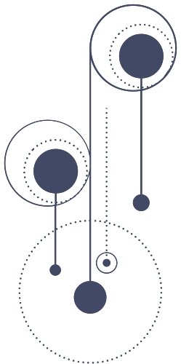



INFORMATION EXTRACTION FROM ROMANIAN DOCUMENTS
Supervisor
Lect. Dr. Lupea Mihaiela Ana
Author
Mocanu Dragoș Marius
BABEȘ-BOLYAI UNIVERSITY CLUJ-NAPOCA
FACULTY OF MATHEMATICS AND COMPUTER SCIENCE
SPECIALIZATION COMPUTER SCIENCE
2025

Slide 2

PROBLEM STATEMENT
Romanian is a morphologically rich, under-resourced language.
Most NLP tools are designed for English and do not handle diacritics, syntax, or Romanian grammar properly.
The goal is to extract structured information (keywords, entities, relations) from Romanian documents.

Slide 3
MOTIVATION & OBJECTIVES
Motivation:
Few effective Romanian NLP tools.
Need for document understanding in education and research.
Objectives:
Implement keyword extraction using RAKE and TextRank.
Perform Named Entity Recognition.
Perform Dependency Parsing.
Build a Knowledge Graph.
Extract WH-question answers.
Extract structured information from unstructed text.
01
02

Slide 4
RAKE
RAKE (Rapid Automatic Keyword Extraction) is a statistical method that extracts key phrases based on how frequently words co-occur between stopwords.
RAKE works as follows:
The text is split into candidate phrases, defined as sequences of words between stopwords.
For each word, RAKE computes:
Frequency: how often it appears in candidate phrases.
Degree: how many other words it co-occurs with.
Co-occurence means that two words appear together within the same phrase or context window, without being separated by stopwords or punctuation.
Each word receives a score = (degree + frequency) / frequency.
Each phrase receives a score equal to the sum of the scores of the words it contains.
Top-ranked phrases are returned as keywords.

Slide 5
TEXTRANK
TextRank is a graph-based ranking algorithm inspired by PageRank, used to identify important words based on their co-occurrence.
TextRank works as follows:
The preprocessed text is scanned for nouns and adjectives, which are used as graph nodes.
The algorithm builds an undirected weighted graph, where:
Nodes = candidate words
Edges = co-occurrence within the window
An iterative scoring formula is applied:
Each node's score is updated based on neighboring scores and normalized edge weights.
Convergence is reached when, for all vertices, the difference between the scores of a vertex is less than a threshold.
Top-ranked nodes are combined into multi-word keyphrases based on their original positions in text.

Slide 6
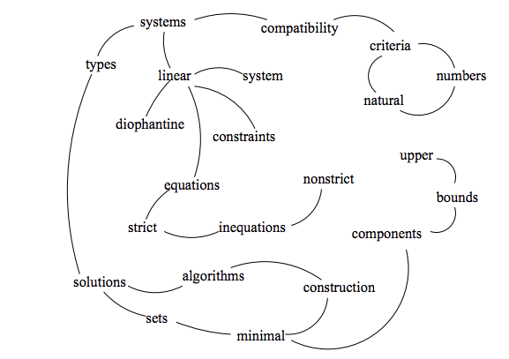
SAMPLE GRAPH BUILD FOR KEYPHRASE EXTRACTION
RADA MIHALCEA AND PAUL TARAU. TEXTRANK: BRINGING ORDER INTO TEXT.

Slide 7
TYPES OF DEPENDENCY RELATIONS
In dependency parsing, words in a sentence are linked through grammatical relations that define their syntactic roles. Below are some of the most common dependency relations in Romanian:
nsubj (nominal subject): indicates the subject of the sentence:
“Ion citește o carte.” → “Ion” is the subject of “citește”.
obj / dobj (direct object): marks the direct object of the verb:
“Ion citește o carte.” → “carte” is the object of the verb.
amod (adjectival modifier): an adjective that modifies a noun:
“carte interesantă” → “interesantă” modifies “carte”.
advmod (adverbial modifier): an adverb that modifies a verb:
“Ion citește repede.” → “repede” modifies the verb.
obl (oblique nominal): complements introduced by prepositions:
“Ion citește în parc.” → “în parc” is a location complement.
nmod (nominal modifier): connects two nouns, often showing possession:
“cartea lui Ion” → “lui Ion” modifies “cartea”.

Slide 8
DEPENDENCY PARSING
In the application, dependency parsing is used to extract semantic triplets. Each sentence is parsed using spaCy's Romanian model to identify verbs, their subjects, and their objects.
Implementation details:
The system iterates through each sentence and searches for verbs (VERB, AUX).
For every verb, the following are extracted:
Subject from dependents with roles like nsubj, nsubjpass
Objects/complements from roles such as attr, acomp, dobj, obj, pobj, obl, xcomp, ccomp
For each valid (subject, verb, object) combination, a triplet is created and stored.
Additionally, adjectival modifiers (amod) and noun modifiers (nmod) are added to capture extra context.
Example:
Sentence: “Ion citește o carte interesantă.”
Triplet extracted: (Ion, citi, carte)
Modifier: (carte → interesanta)
These triplets are used to build the Knowledge Graph and power the WH-question answering feature.

Slide 9
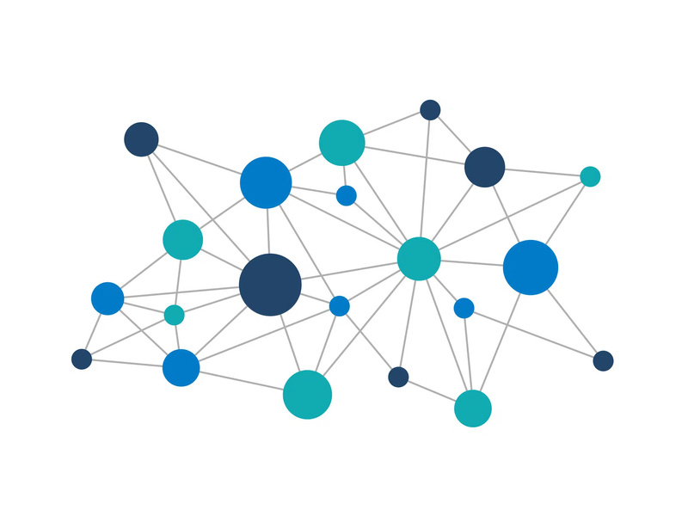
KNOWLEDGE GRAPH
What is a Knowledge Graph?
A knowledge graph is a structured representation of information in the form of triplets (subject, verb, object). Subjects and objects are the nodes of the graph, and the verbs are the edges of the graph.
It models relationships between entities to enable reasoning, search, and question answering.
Where is it used?
Search engines (e.g., Google Knowledge Graph)
Virtual assistants (e.g., Siri, Alexa)
Recommender systems
Biomedical data analysis
In the application it is used to answer WH-questions

Slide 10
WH-QUESTION ANSWERING
The system automatically answers WH-questions (WHO, WHAT, WHEN, WHERE, HOW) based on the extracted semantic triplets and named entities.
Implementation steps:
After dependency parsing, triplets (subject, verb, object) are created.
Named Entity Recognition is applied to tag people, locations, organizations, and dates.
Questions are answered by selecting triplet components and/or entities:
WHO → returns subjects (e.g., nsubj)
WHAT → returns objects (e.g., obj, dobj, xcomp)
WHEN → uses NER to detect dates/times
WHERE → uses NER to detect locations
HOW → extracts cause expressions containing specific patterns:
e.g., “deoarece”, “pentru că”, “fiindcă”

Slide 11
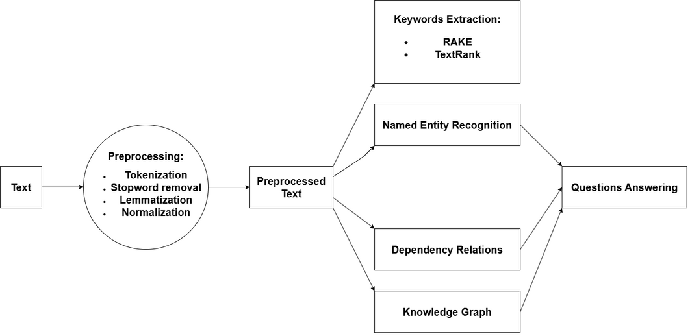
APPLICATION OVERVIEW
The application starts by preprocessing the Romanian input text, continuing with keyword extraction. Named entities are identified using a Romanian spaCy model, while dependency parsing is used to extract grammatical relations and semantic triplets. Based on these, a knowledge graph is constructed, and answers to WHO, WHAT, WHEN, WHERE, and WHY questions are generated. All results are presented in an interactive web interface with tabbed visualization.

Slide 12
EXAMPLE
“Andrei a trimis raportul din Cluj pe 10 mai pentru că termenul limită era aproape.”
Preprocessing:
Lowercasing - all characters are converted to lowercase
"andrei a trimis raportul din cluj pe 10 mai pentru că termenul limită era aproape."
Normalization - removes diacritics, punctuation and extra spaces
"andrei a trimis raportul din cluj pe 10 mai pentru ca termenul limita era aproape"
Tokenization - the sentence is split into individual tokens
[andrei, a, trimis, raportul, din, cluj, pe, 10, mai, pentru, ca, termenul, limita, era, aproape]
Stopword Removal
[andrei, trimis, raportul, cluj, 10, mai, termenul, limita, aproape]
Lemmatization - each token is reduced to its base form
[andrei, trimite, raport, cluj, 10, mai, termen, limita, aproape]

Slide 13
OUTPUT
“Andrei a trimis raportul din Cluj pe 10 mai pentru că termenul limită era aproape.”
RAKE keywords: “trimite raport”, “termen limita”, “andrei”, “cluj”, “aproape”
TextRank keywords: “termen limita”, “raport”
NER:
PERSON: “andrei”
GPE: “cluj”
DATETIME: “10 mai”
Triplets: “andrei” → “trimite” → “raport”
QA:
WHO: “andrei”, “termen”
WHAT: “raport”
WHERE: “cluj”
WHEN: “10 mai”
WHY: “pentru ca termenul limita era aproape:”

Slide 14

CONCLUSION
The developed system successfully extracts and organizes meaningful information from Romanian texts.
It demonstrates that integrating custom Romanian language processing pipelines can significantly improve document understanding in under-resourced languages.
The application is functional, extensible, and ready for educational or research use.

Slide 15
FUTURE WORK
Database Integration
To enable persistent data storage, the output data will be stored in a database
Automated Summary Generation
An useful update would be automatic summarization, particularly using sentence level ranking based on TextRank
Cloud Deployment
To support broader usage in educational platforms, the backend can be deployed to the cloud, where users could create accounts and their upload history would be saved

Slide 16
THANK YOU

